Slide 1



Paper No. : 1570200571 A Methodology for Detection and Localization of Dynamite Fishing
Department of Electrical Engineering
Faculty of Engineering & Technology
Jamia Millia Islamia, New Delhi, India
IEEE India Council
Authors Name & Affiliation
S. S. Bharadwaj¹, B.N. Sumukha¹, R. C. Kumar¹, S. Simha², H. S. Jamadagni², and K. George^{1,3}
¹Dept of Telecommunication Engineering, PES Institute of Technology, Bangalore, India
²Dept of Electronic Systems Engineering, Indian Institute of Science, Bangalore, India
³PES Centre for Intelligent Systems, Bangalore, India

Slide 2
Objective
To detect and localize, if and where a dynamite blast has occurred.

Slide 3
Motivation
Dynamite Fishing indiscriminately kills a large numbers of fish along with other marine organisms.
Destroys the physical environment and ecosystem including extensive damage to coral reefs.
A solution to the above problem can be achieved using the techniques of DSP.

Slide 4
Literature Survey

Slide 5
Proposed Methodology

Slide 6
Methodology
Two major steps :
Detection
Pre-processing
Feature Extraction
Pattern Classification using Artificial Neural Network
Localization
RSSI based Triangulation

Slide 7
Signal Database
Two categories
Blast (Bombs, dynamite explosions)
Non – Blast (Thunder, storm, gunshots)
A total of 34 signals with 17 blast and 17 non-blast
signals are considered to test the methodology.

Slide 8
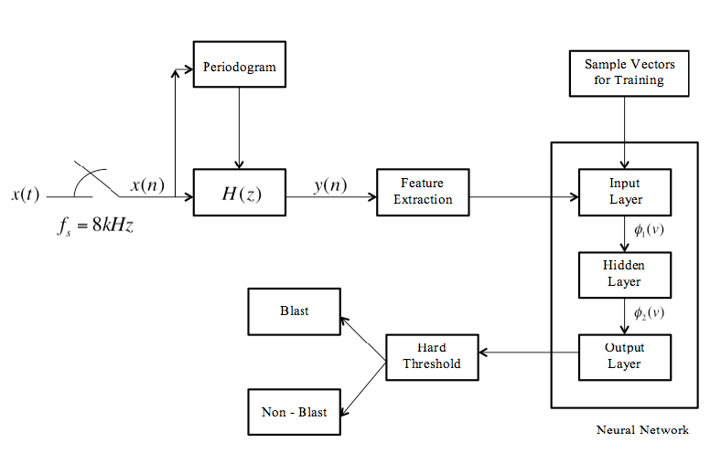
Design Flow of the proposed method : Detection

Slide 9
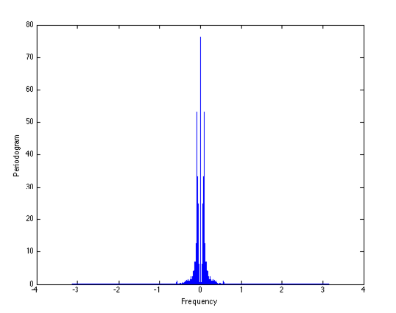
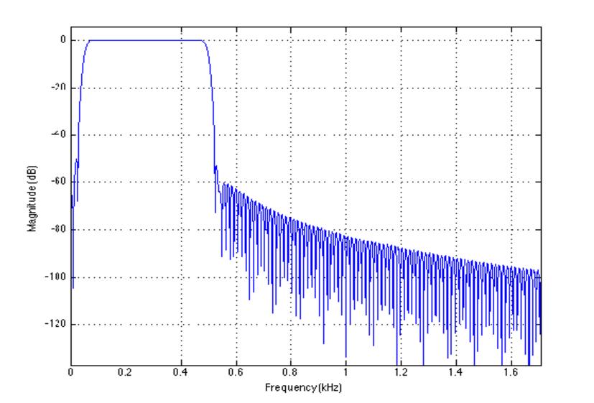
Detection : Preprocessing
Preprocessing
Spectrum Estimation Using Periodogram
Energy of the signal lies between the
frequency range of 50Hz and 450Hz
Filter Design
Band-pass FIR filter with 566 coefficients is
designed using Hamming window to extract
the signal.

Slide 10
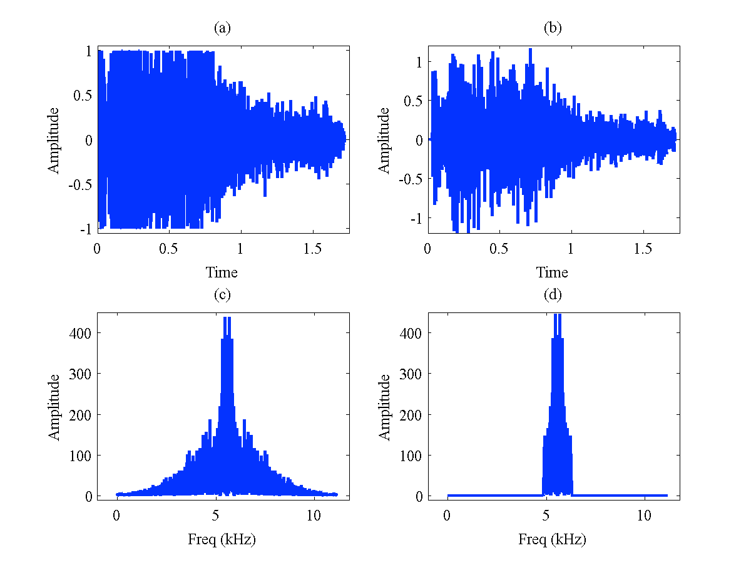
Detection : Preprocessing

Slide 11
Detection : Feature Extraction
Feature Extraction
3 sets of features
Parameters related to Statistics of the signal
Parameters related to Spectrum of the signal
Parameters related to the compressed form of the spectral envelope of the signal – LPC Coefficients
Feature vector totally consists of 60 elements

Slide 12
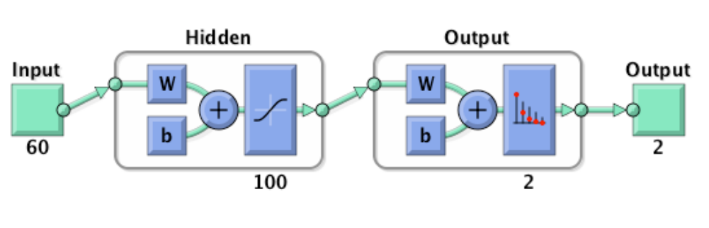
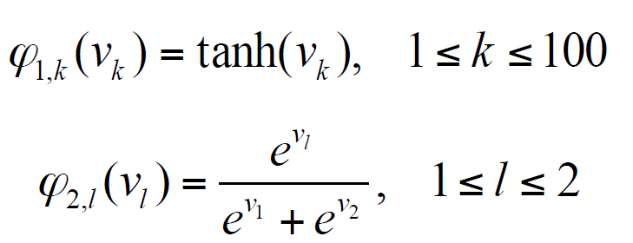
Detection : Artificial Neural Network for Pattern Classification
Challenge : All the signals lie in the same spectrum
The Neural Network Model : Supervised learning with Back propagation algorithm
2 class problem : Blast and Non-blast

Slide 13
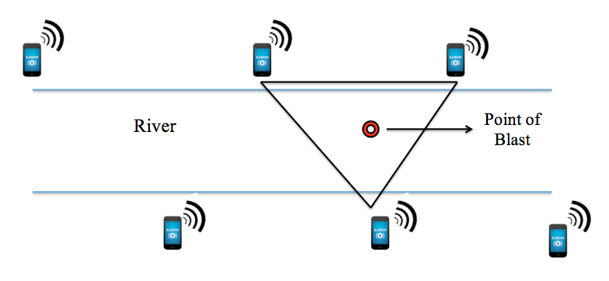
Localization : Scenario
Received Signal Strength Indicator (RSSI) based triangulation

Slide 14
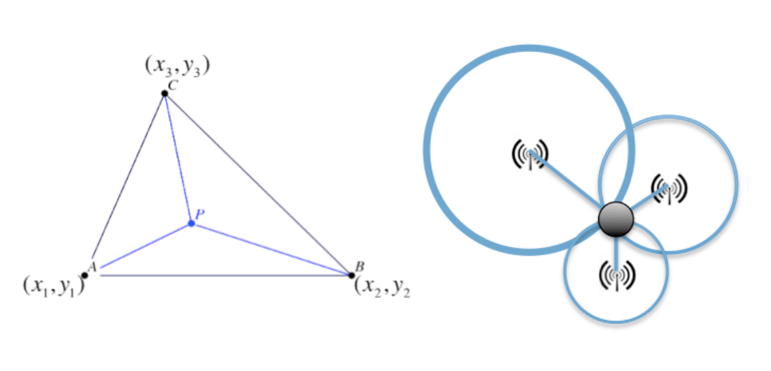
Schematic design of the proposed method : Localization
A solution to the intersection of the three circles drawn with the nodes as their centers and the distances between the nodes and the point of blast as radii provides the coordinates of the blast.

Slide 15
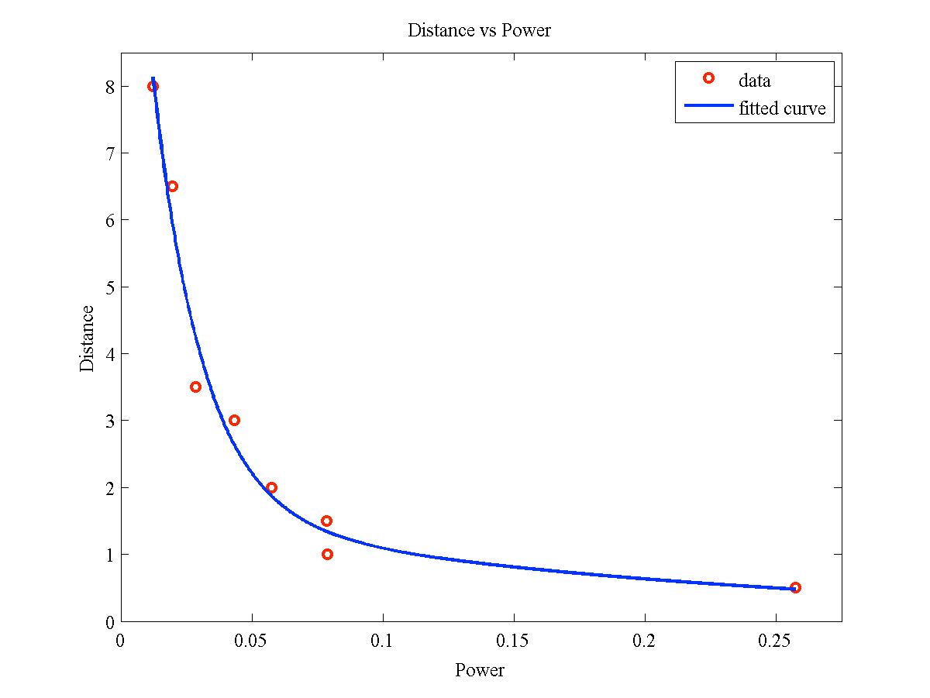
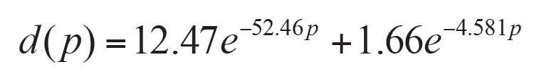
Localization : Radio Propagation Model
Distance as a function of Received Signal Strength
Curve fitting using non-linear regression analysis
Function approximation using artificial neural network

Slide 16
Results and Discussions

Slide 17
Classification
A total of 34 signals database is split as follows
28 (80%) – Training the neural network
03 (10%) – Cross validation
03 (10%) – Testing

Slide 18
Classification
Interesting observation :
If only the parameters related to statistics and power spectrum of the signal are considered for training, then the achieved classification accuracy is only 88%.
On the contrary, if only LPC coefficients are used then the accuracy is 94%.
When the feature vector is formed by appending all the 3, the classification accuracy achieved is 100% for the considered set of signals.

Slide 19
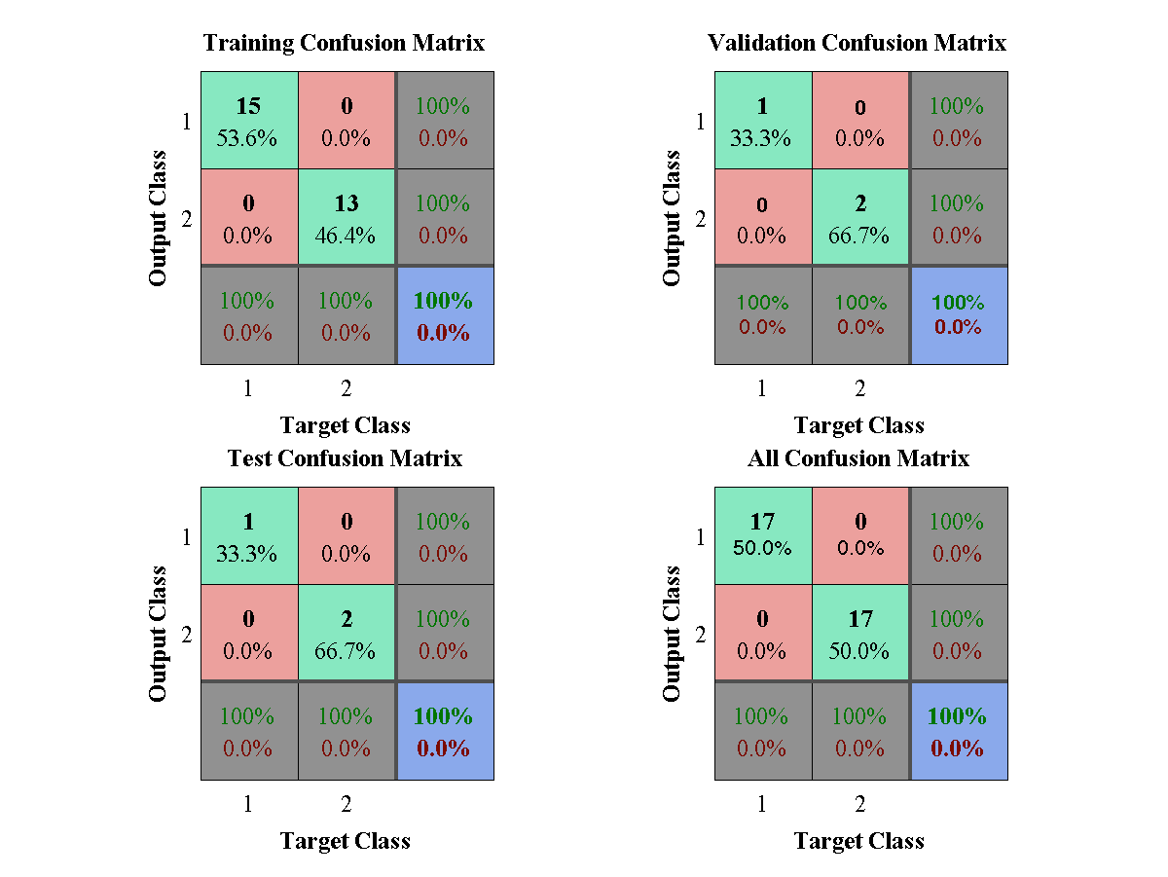
Classification Accuracy

Slide 20
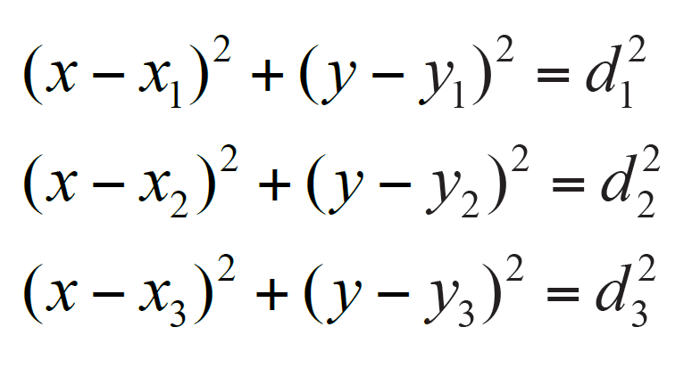
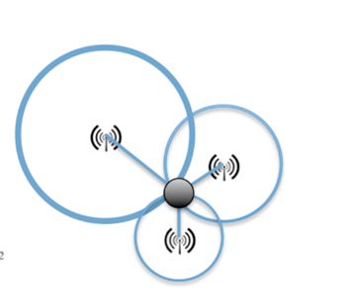
Localization
We obtain the distance versus power plot. A curve is fit to the measured data using nonlinear regression analysis. Resulting equation is
Using this relationship, the three circles are drawn and the location of the blast is determined.
The accuracy of localization is found to be 94%.

Slide 21
Summary
We developed a methodology for detection and localization of dynamite blast fishing.
The achieved accuracy of pattern classification is 100% by the particular choice of the feature vector. The detection included statistical parameters; parameters derived from the power spectrum of the signal, and LPC coefficients.
The location of the dynamite blast is determined using triangulation with RSSI as a measure, and nonlinear regression analysis of the measured data. The location prediction accuracy achieved is 94%.
Work is currently in progress for real-time deployment in field trials. Towards this, the developed methodology has been successfully implemented on Intel Galileo Gen 2.

Slide 22
Thank You Questions ?

